Slide 1


India’s Health System in the Time of COVID-19
July 6th, 2020

Slide 2
Key Messages
India’s health system has made significant progress in global perspective on many indicators
But there are large, persistent health gaps among states and COVID-19 has exposed fault-lines
  Under-investment overall and for public health, shortcomings in quality of care, neglect of urban health
A health system for the 21st century
  Imperative of more government financing, mainly through prioritization of health in state budgets
  But larger health budgets will not have the desired impact without…
    Health financing reforms to “spend better”
    A new approach to inter-fiscal relations for health, with greater focus on equity/need, performance & accountability, urban areas/municipalities, and pro-health taxes
    Service delivery reforms, but not one-size-fits-all – Govt of India should adopt an “open-source” federal model to empower states to chart their own paths, leveraging technology and innovation; major challenge ahead to build primary care foundation, address non-communicable disease (NCDs)
    Investments in core public health functions for disease control, including institutional strengthening and coordination for pandemic response

Slide 3
Outline
COVID-19 in India
Current situation and impact
A snapshot of India’s health system performance
    Achievements and challenges
Getting Better: A health system for the 21st century
Better health financing, service delivery, and public health

Slide 4
COVID-19 in India: Current Situation and Impact

Slide 5
COVID-19 in India: Current Situation
Globally, pandemic has peaked in many countries, including China. Many countries including Thailand and Vietnam appear to have managed to control the epidemic. The locus is shifting to South Asia and Latin America.
India has now overtaken Russia to have the third highest number of daily cases in the world (behind Brazil and USA).
Incidence was localized to large extent in urban densely-populated clusters: Delhi, Mumbai, Chennai but is spreading to rural areas.
Almost 15,000 deaths in total due to COVID-19 in India to date, compared to 125,000 in USA and almost 55,000 in Brazil. Per capita rates low in India.
Transmission has picked up since the lockdown – one of the most stringent globally – was relaxed.

Slide 6
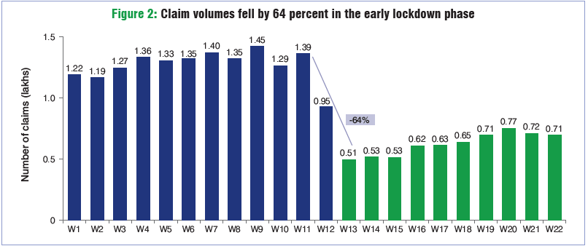
Collateral damage: Heavy toll on non-COVID health care…
In normal times, 90% of those reporting an ailment seek outside medical advice; during lockdown, about 40% did so.
PM-JAY utilization (hospitalization among poor) declined by 64% during the early lockdown, and by 51% during full 10-week lockdown, including 25% for deliveries and 64% for cancer care.
TB case notification in April 2020 was 84% lower than in April 2019. One recent study estimates 95,000 additional TB deaths over the next 5 years due to collateral effects of COVID-19.

Slide 7
…and to the economy and other sectors
As is often the case with pandemics, adverse economic impact is likely to be proportionally larger than the direct impact of the coronavirus on morbidity and mortality.
Per capita GDP projected to decline by -6%, one of the largest contractions the country has ever seen, and -11% compared to trend growth rates over 2009-2019. Revenue contraction also expected (~2% of GDP) as well as a rise in the overall deficit.
Economic cost of COVID-19 in India projected to be among the highest in Asia, surpassing even China where the coronavirus was first discovered. Poverty rates are expected to increase, those in the informal sector and rural migrants expected to be some of the worst hit.
Many other sectors also adversely impacted: education, tourism, hospitality, trade, etc..

Slide 8
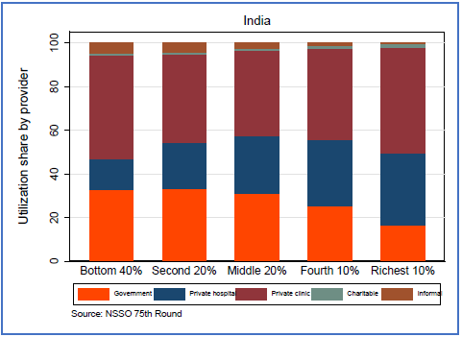
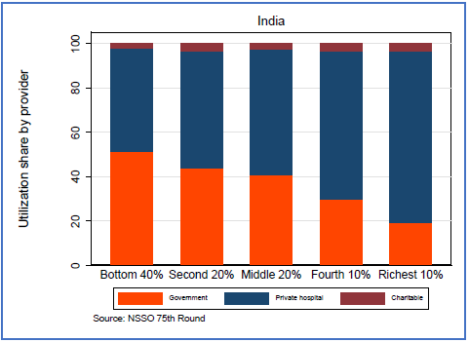
COVID-19 has exposed India’s health system fault-lines
Insufficient focus on core public health functions: disease surveillance, testing, contact tracing.
Weaknesses in service delivery despite improvements in access, including supply-side readiness challenges and high variations in quality of care.
Inadequate attention to urban health systems, and to municipalities as a critical layer of government for health
Low levels of public financing for health and high levels of out-of-pocket (OOP) financing for health, latter is risk factor for impoverishment.
  Outpatient utilization in past 15 days
  Inpatient utilization in past 365 days
Huge fragmentations in service delivery across public vs private provision, an especially large role for latter in provision of health services: 70% of outpatient utilization and 58% of inpatient utilization on average occur at private facilities; utilization rates are higher at public facilities among the bottom 40%, but even for them private provision is relatively high.

Slide 9
A Snapshot of India’s Health System Performance

Slide 10
Strong recent performance on many indicators…
Life expectancy at birth has risen to ~70 years, up from 58 years in 1990 and only 41 years in 1960. Above average for its income level.
Under-five mortality rate is 37 per 1,000 live births; at current trends, India is on-track for attaining the 2030 SDG target of 25.
Infant, under-five and maternal mortality are all very close to the global average for India’s income level.
Total fertility rate (TFR) is 2.3, almost at replacement; several states including AP, Kerala, Tamil Nadu have TFR rates below replacement.
Huge gains in skilled birth attendance, institutional deliveries, immunization.

Slide 11
…but uneven progress in comparative perspective
Performance on key population health outcomes lags that of peers in South and East Asia
Stunting rates among children under-five are among the highest in the world as are anemia rates among women of reproductive age
One of the few countries globally where under-five mortality for girls is greater than for boys
Non-communicable diseases (NCDs) account for largest share of disease burden, but effective coverage is poor
Highest TB burden in the world, with large economic costs; 700,000 cases not being treated/reported annually; private sector mismanagement leading to drug resistance and continued high transmission rates
High burden of road traffic injuries.

Slide 12
Huge and persistent variation across states in key health outcomes
Some states have health outcomes similar to sub-Saharan Africa, others resemble East Asia
Between 2005 and 2016, little or no convergence between India’s lagging and leading states on:
  Infant & under-five mortality
  Stunting & under-weight children
Very little convergence in state-wise health financing levels
Positive convergence story only for immunization coverage and institutional births

Slide 13
Quality of care as a cross-cutting challenge
Quality of care has emerged as a key issue in India’s health system
  Poor quality of care
    Some progress in terms of structural quality
    (e.g., input availability per NQAS certification)
    Process quality remains particularly poor
  Huge variability in quality of care
    Across states
    Across levels of care
    Across types of providers
    Even by the same doctor whether
    practicing in the public or private sector
Quality of care is a global challenge, with more deaths in LMICs estimated to be due to poor quality rather than lack of access
 | HAQ* Index (2015) | 2015 Ranking
Maldives | 75.5 | 1
Sri Lanka | 72.8 | 2
Bhutan | 52.1 | 3
Bangladesh | 51.7 | 4
Nepal | 50.8 | 5
India | 44.8 | 6
Pakistan | 43.1 | 7
Afghanistan | 32.5 | 8
*HAQ=Healthcare Access & Quality index
In LMICs, 5 million deaths are due to poor quality among people using care; 3.6 million from lack of access**
* * Lancet Global Health Commission on High Quality Health Systems in the SDG Era

Slide 14
India’s population age structure offers
both opportunities and challenges
India’s productive potential is rising:
  Demographic transitions have led to rising worker-to-dependent ratio which will be a favorable 2.1 by 2050.
  The number of adolescents grew from 225m in 2000 to 250m in 2015
  But investments in children and adolescents needed for better health, nutrition, cognition and productivity
Furthermore, India has an increasing aging population:
  This implies challenges around chronic diseases, NCD management, elder care and social security
In addition, growing risk factors from obesity, climate change, urbanization, and air pollution
1.9
2.1
Source: United Nations 2019

Slide 15

Getting Better: A Health System for the 21st Century

Slide 16
Public financing should predominate
Total health spending is currently ~3.5% of GDP, over 60% is financed by out-of-pocket payments (OOP).
OOP financing for health is both inequitable and inefficient. It is a major risk factor for impoverishment: An estimated 60 million Indians pushed into poverty annually as a result of high OOP spending.
WHO recommends OOP spending should be 15-20% of total health spending (e.g., Thailand and OECD).
Predominantly public financing is essential for achieving universal health coverage (an SDG target); private financing does not play a central role in mature systems.

Slide 17
Budget prioritization of health is the major constraint to more spending
At ~1% of GDP (~US$20 per capita), India’s government health spending is among the lowest in the world, despite a steady increase in real terms due to economic growth.
National Health Policy 2017 target to reach 2.5% of GDP by 2025, but with about 2/3 of spending at state level, the main responsibility to spend more is at state level.
Low priority to health is the major constraint. Health share of consolidated government spending <4% in India, global average is ~11%. India ranks about 175th out of 190 countries in budget prioritization of health, in the same range as fragile and donor-dependent countries.

Slide 18
Spending more is not sufficient, India must spend better too
  Achievement of key health financing objectives – resource mobilization, risk-pooling, efficient purchasing, and equity – should guide the reform agenda
  Scope to spend better:
      PFM reforms to improve budget execution, enable service delivery, and find the right balance between flexibility and control
      Resource allocation formulas to inform allocations from states to districts to better reflect population need (mortality/morbidity/equity), not historical norms
      Gradual shift to demand-side financing modalities to bring India in alignment with norm in advanced health systems – but at a different pace across the country (PMJAY, TB program already pushing this agenda)
      Reduce fragmentation of health protection schemes (CGHS, ESIS, PMJAY, state schemes)
      Ensure pro-poor focus of health financing
      Better service delivery and public health investments (as described below)

Slide 19
Missing elements in the federal health financing system
Renewed focus on equity/need:
  NHM: per capita spending very weakly correlated with state “need” (e.g., mortality rates, income level)
  PMJAY health insurance: spending per beneficiary is higher in more advanced states
  Very little convergence among lagging and leading states in key health outcomes or health financing during 2005-2016
  Many federations have strong needs-based transfer formulas for health (see annex) and/or variable cost-sharing formula
  Separate health equalization pot with TA support to “lift the floor” on key outcomes?
A greater role for performance and accountability
  NHM is expanding its performance-based financing (up to 20 percent, largely determined by NITI Aayog health index)
  Explicit accountability frameworks (“compacts”) including target results – linked to state spending levels and outcomes?
Greater attention to resource allocation within states
  Major urban areas are under-powered to address urban health challenges
  Weak links between district need (mortality, poverty) and district allocation within states
  Provide direct transfers from Govt of India to large urban centers? (to help unlock potential of urban India)
A robust “pro-health tax” framework
  Excise taxation – especially for tobacco – would raise revenues and have a huge positive impact on population health

Slide 20
Getting Better: A Health System for the 21st Century

Slide 21
Ingredients, not recipes, for service delivery reform
Service delivery reform is happening in India, but needs to be accelerated, broadened, and deepened
Unlike financing, where public must predominate, service delivery can rely on a robust public/private mix; but a strong public option serving as a “market anchor” and focused on lower quintiles will be important
No single model or “recipe” can be decreed; wide variation prevails even among advanced health systems
But there are key ingredients as embodied in common service delivery transitions as systems mature. A shift from:
Transition speed will vary widely across states
From… | To…
Reproductive and child health | Chronic non-communicable disease (NCD) management
Chronic bypassing of lower levels | Strong preventive/promotive primary care foundation
Focus on access to care | Focus on quality of care
Accounting (counting inputs) | Accountability (measuring processes, outputs, outcomes)
Top down MoH/DoH management | Provider autonomy, purchaser/provider split
Fixation on public sector | Strategic engagement of private sector
Paper-based: Weak information | Digital: Huge volumes of data to inform clinical & policy decisions
Health care workers as “headcounts” | Professionals to be well-trained and continuously supported
Patients as passive beneficiaries | Active participants in a continuum of care
Rural focus, urban neglect | Urban focus and innovation

Slide 22
An “open source” federal system to promote service delivery reform
  Transfer system need not pre-determine the service delivery system; GoI can be open to accommodate many paths
  Many critical areas will not have an “all India” standard approach, reflecting local characteristics, preferences, and capacity and governance constraints. For example:
      Degree of autonomy for local and urban governments to step up in health service delivery
      Role of non-state providers, both formal and informal, especially for primary care
      Readiness for demand-side financing agenda vs. continued supply-side approach varies
    Government of India can be an enabler for the open-source approach
      Common good provision (medical research, clinical protocols, data systems)
      Financing via centrally-sponsored schemes that allows flexibility in implementation and course-correction
      Setting accountability mechanisms with states linked to central schemes
      Promoter of knowledge transfer platforms
      Financier of service delivery experimentation via innovation funds and M&E support

Slide 23


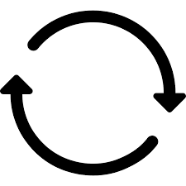

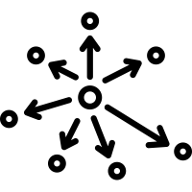


7 SHIFTS accelerated by COVID-19
Service delivery innovations
Wide open canvas for service delivery innovations in India, from urban slums to last-mile delivery in remote areas, with huge scope for technology solutions
Some already ongoing and promising: Andhra Pradesh urban private PHC contracting: Primary health care centers in urban areas run by contracted private providers (with performance-based MoUs); Outpatient services with outreach, telemedicine services for specialist consultations, electronic medical records
Unlocking health value chain in India through public-private partnerships at scale including areas of digital technology, data science, bottom of pyramid models; and multi-sector actions and community mobilization (great progress on sanitation, water, air pollution, nutrition, road safety, gender-based violence, etc.)
Distributed: health care must be delivered not only in fixed facilities, but also in workplaces, communities, and people’s homes by a wider cadre of health workers including patients themselves and their caregivers
Connected: share data with each other and systems outside of health care and be available to health workers and patients on mobile devices
Continuous: healthcare must serve people during the 5000 waking hours of the year, not only the 15 minutes they spend in a fixed facility
Human centered: healthcare needs to put the patient and their caregivers at the center and empower health workers
Decentralized: decision-making needs to be less concentrated and put more into the hands of local leaders, health workers, and ultimately patients
Collaborative: healthcare must seamlessly combine the insights of non-experts, experts, and non-human agents
Responsive: the system needs to automatically adapt itself to new data and new diseases

Slide 24
Getting Better: A Health System for the 21st Century

Slide 25
Strengthening core public health functions
Strengthen core public health functions
      Institutional reforms and innovations in vertical disease programs (TB, HIV, RCH)
        Private sector engagement at scale for TB diagnosis and treatment
        Performance-based incentives to states and districts through TB Performance Index
      Public health cadres to execute core public health functions at national, state and district levels
Production of global public goods – new vaccines, medicines and diagnostics
Multisector response to tackle social determinants of health and nutrition outcomes
  Access to clean water & sanitation
  Prevent and mitigate the impact of air pollution on population health
  Other drivers: gender, education, etc.

Slide 26
Strengthening surveillance and district level capacity to identify and respond to future epidemics
Roll-out targeted investments to enhance integrated public health laboratory infrastructure and functions in states where capacities are weak
Develop and deploy district surveillance teams with core competencies in integrated disease surveillance across different states and at the central level to enhance analytical capacity for early and appropriate response (Epidemic Intelligence Service)
Develop and roll-out real time surveillance & reporting system for Human and Animal Health Surveillance as most future outbreaks will be Zoonotic
Strengthen national and state institutions to effectively prepare for pandemics (NCDC) and develop ICMR as a global center for excellence in medical research
Strengthen inter-agency coordination for disease preparedness and response

Slide 27
Strengthen key Indian institutions for disease preparedness, diagnostics, investigation, response and population health
ICMR
Research Promotion Molecular research Population-based studies, including social epidemiology Research on exotic and evolving Zoonotic diseases Collaborative research – regional and international External quality assurance for viral laboratories Platform for engaging private sector to build diagnostic capacity – test kits, reagents and new testing approaches
NCDC
Stewardship for disease surveillance Ensure India’s compliance on IHR One Health platform coordination Nation-wide surveillance capacity building – Field Epi training Digital technology for tracking diseases Alerts on new and exotic diseases Weekly epidemiological and outbreak reports Internal quality assurance – laboratories Pandemic preparedness assessment – table top exercises
NDMA
Strengthening legal framework for pandemic response
Support responses – Lockdowns/large-scale evacuations
Maintaining stock-pile for responding to pandemics

Slide 28
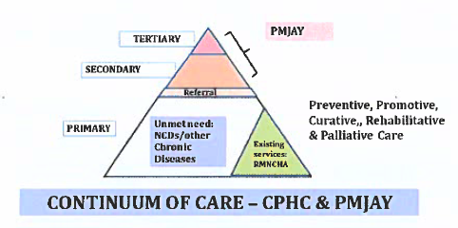
Element of need-based transfers to states for improving health
Central role: public goods, setting standards, annual survey data collection, ensuring accountability, monitoring, mentoring, stewardship, cross-state learning, state-capacity building
Integrated service delivery model with district at core
Accountability for ensuring adequate state-level co-financing, infrastructure, human resources for health
Health & wellness centers first point of entry for promotive, preventive, surveillance (including for NCDs), and for help navigating health system
CGHS/ESIS
Integration including across all health schemes/programs
Flexibility for states in how to use and allocate funds, encouraging separation in payer-provider roles
Electronic health records, pro-active risk stratification
Performance-based transfers based on range of effective/quality-adjusted intermediate outcomes: MCH, TB, pandemic preparedness, NCDs, and financial protection.
Flexibility in service delivery organization and encouraging innovation and focus on quality; contracting-out and contracting-in private provision; use of telemedicine, AI, mobile clinics
Focus on what are we buying with additional public financing for health

Slide 29
Increasing and consolidating public financing for health with focus on outcomes
Current system
Future system?
Consolidated Revenues
Consolidated Revenues
Central Level
ICMR, NCDC, Central hospitals, etc.
Central Level
ICMR, NCDC, Central hospitals, etc.
Health-related needs-based direct transfers to large municipalities?
Centrally-Sponsored & Other Schemes (NHM, PMJAY, TB)
Consolidated Financing
(NHM, PMJAY, CGHS, ESIS)
SHI schemes (CGHS, ESIS)
Health-related needs-based transfers, holding states accountable for results
State Level
State-Level Revenues
State Level
State-Level Revenues
Districts
Municipalities
Districts
Municipalities
Public Providers
Private Providers
SHI Providers
Public Providers
Private Providers
SHI Providers
Limited health-related needs-based transfers, fragmented health financing and service delivery, limited focus on results, not enough public financing
Health-related needs-based transfers, increased and consolidated health financing, integrated service delivery with focus on using innovation and technology to achieve results

Slide 30
Summary
Context
- COVID-19 is claiming lives, inflicting damage across health system and entire economy, and exposing fault-lines in the system
- India has made good progress on key health indicators but lags in other areas; over 10-15 years, not much convergence among states
- Outstanding challenges related to disease control, epi/demographic transitions, quality of care
Better health financing
- Predominantly government financing
- Prioritization of health in state budgets
- Better spending through reforms
- Revamp federal financing to better address equity/need, performance & accountability, allocations within states, and pro-health taxation
Better service delivery
- Ingredients, not recipes, for service delivery
- Public/private mix with robust public option
- Multiple service delivery transitions must happen
- GoI has critical role to play in promoting “open-source” model for state service delivery systems
- Innovations should be nurtured
Better public health
- Strengthen surveillance and public lab capacity at district level including zoonotic diseases
- Prepare national and state institutions to effectively respond for pandemics and research (NCDC and ICMR) as per IHR
- Promote institutional reforms and innovations in vertical disease control programs (TB/HIV/VBD)

Slide 31
Annex: Inter-fiscal transfers in federal health systems

Slide 32
Many countries have needs-based transfers using formulas including health indicators
Argentina: 60% needs based (per capita for maternity under “Plan Nacer”)
Australia: Partly needs-based health transfers (indicators unknown)
Brazil: 10 indicators, mostly mortality based
Indonesia: Needs-based, partly reflecting a “human development index”
Pakistan: ~10 indicators for needs-based component, some health-specific
Italy, Norway, Portugal, UK: Health-specific indicators for determining need
South Africa: 11 indicators, demographic/social, not health-specific
China and Russia: Needs-based, but not health-specific
Canada: Per capita only

Slide 33
A few countries have performance-based health transfers
Argentina: 40% of transfer is performance-based, with 14 health indicators (mainly maternal and child health)
Australia: 30 performance indicators under National Health Agreement (but funds are generally not withheld if not achieved)
Brazil: Performance transfer to municipalities dropped due to political resistance
Indonesia: Performance-based community block grant based on 12 indicators (including 8 related to maternal and child health)

